Slide 1
TED Talk
Bits Please

Slide 2
_______ has made the greatest contribution to the development of computing.

Slide 3
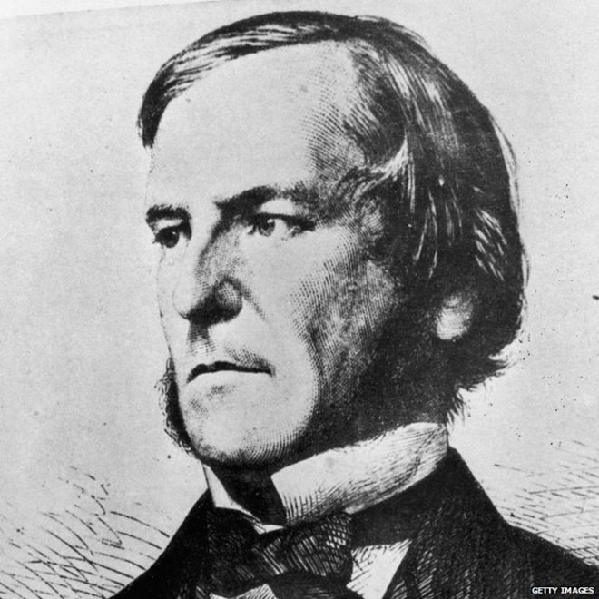
George Boole (1815 – 1864)

Slide 4
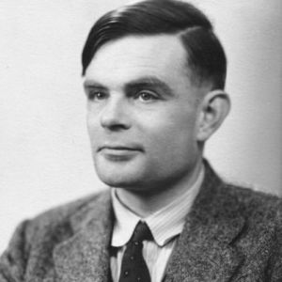
Alan Turing (1912-1954)

Slide 5

Tim Berners-Lee (1955 - )

Slide 6

Bill Gates (1955 - )

Slide 7

Steve Jobs (1955 – 2011)

Slide 8
What about War?
Does war drive technological advancements?
Telegraph
Mass radio
Radar
GPS
Internet
Silicon Valley

Slide 9
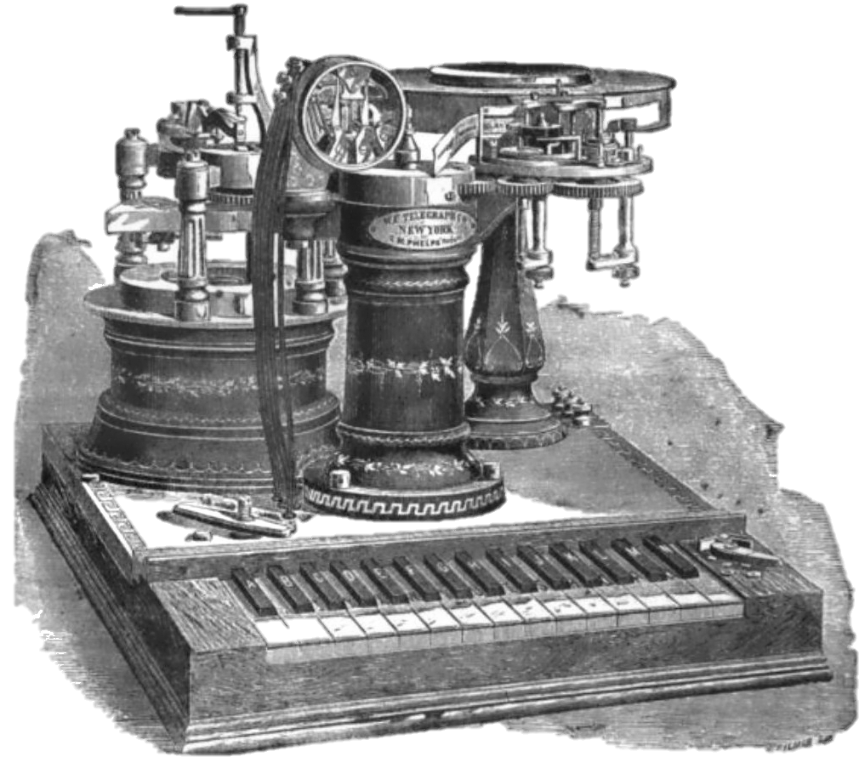
Telegraph – American Civil War
The telegraph was in theory the first ‘internet’
4,000 miles of telegraph wire in 1862
More than a million messages sent to and from the battlefield.
It allowed communications to be sent over long distances at a rapid speed.
Innovations like this did not just change the way people fought wars–they also changed the way people lived.

Slide 10
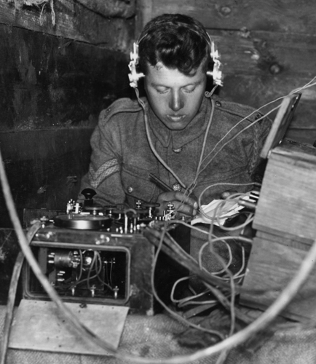
Radio – World War I
AT&T—in collaboration with the Signal Corps—made great advances in manufacturing:
Vacuum tubes (valves).
Smaller receivers
More powerful transmitters
Laid the foundations for the transistor in many years to come.

Slide 11
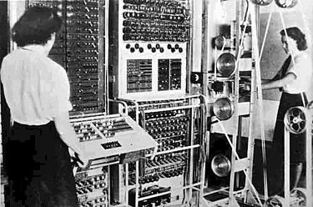
Collossus – World War II
Used thermionic valves (vacuum tubes) to perform Boolean and counting operations.
Regarded as the world's first programmable, electronic, digital computer.

Slide 12
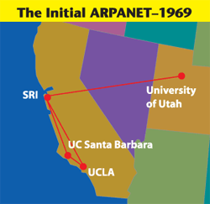
The Internet
1960s, the U.S. Department of Defense funded a project called ARPANET.
Developed the technologies and protocols necessary to allow multiple computers to connect directly to one another.

Slide 13
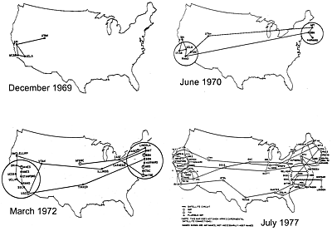
The Internet
Multiple separate networks could be joined into a network of networks.
In 1983, ARPANET was divided into two parts, MILNET, to be used by military and defense agencies, and a civilian version of ARPANET.

Slide 14
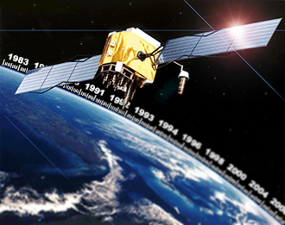
GPS – Cold War
Developed by the U.S. military in the 1970s as a Cold War weapon.
A team of U.S. scientists monitoring Sputnik's radio transmissions
1983, President Reagan signs an executive order allowing civilian use of the Pentagon’s Global Positioning System.

Slide 15
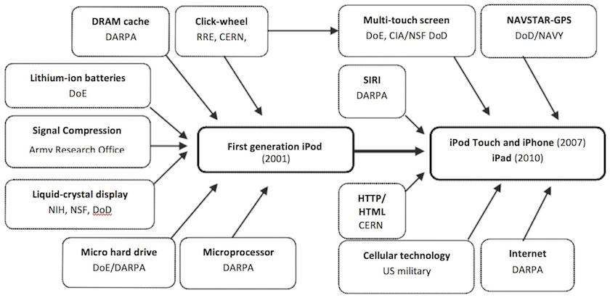
What about Steve Jobs?

Slide 16
What about Bill Gates and Tim Berners-Lee?
oN-Line System (NLS)
GUI
Onscreen Windowing with a Mouse
Hypertext Linking

Slide 17



Who funded this research?

Slide 18
Where did Silicon Valley come from?
After Pearl Harbour in 1942, a great deal of the U.S. military forces and of the military production was moved to California.
Cold War and the arms race, the Korean conflict, the "missile gap" and the space program, the Pentagon kept ordering high-technology products from the armament factories in California.
Military funding for high-tech products was responsible for the early growth of Silicon Valley in the 1950s and 1960s.
DoD purchases represented about 70 percent of the total production of ICs in 1965.
While this share in chip demands has dropped to 8 percent today, the Pentagon remains the biggest supporter of new technologies and accounts for most of the purchases of the latest developments.

Slide 19
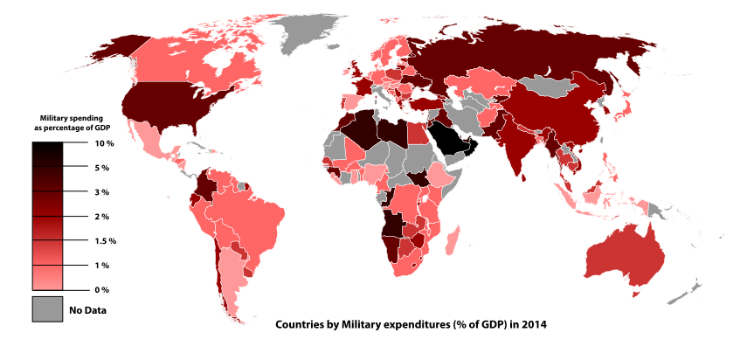
Source: Wikipedia

Slide 20

What does the future hold?

Slide 21
References
References:
Slide 9:
http://www.history.com/topics/american-civil-war/civil-war-technology
Slide 10:
http://www.popularmechanics.com/military/research/g1577/7-surprising-scientific-advances-that-came-out-of-world-war-i/
Slide 11:
https://en.wikipedia.org/wiki/Cryptanalysis_of_the_Enigma
Slide 12:
https://en.wikipedia.org/wiki/Colossus_computer/
https://en.wikipedia.org/wiki/History_of_computing_hardware
Slide 13 + 14:
https://en.wikipedia.org/wiki/ARPANET
http://science.howstuffworks.com/war-drive-technological-advancement1.htm
https://www.britannica.com/topic/ARPANET
https://en.wikipedia.org/wiki/DARPA
Slide 15:
http://www.bloomberg.com/news/articles/2014-12-04/gps-as-we-know-it-happened-because-of-ronald-reagan
http://www.fleetistics.com/history-gps-satellites.php
Slide 17:
http://www.alphr.com/features/373546/10-brilliant-darpa-inventions
Slide 18:
http://www.silicon-valley-story.de/sv/militFunding.html
Slide 19:
http://www.defense.gov/News/Article/Article/686507/carter-reviews-new-technologies-from-dods-silicon-valley-unit

